Slide 1
The Grand Budapest Hotel

Slide 2
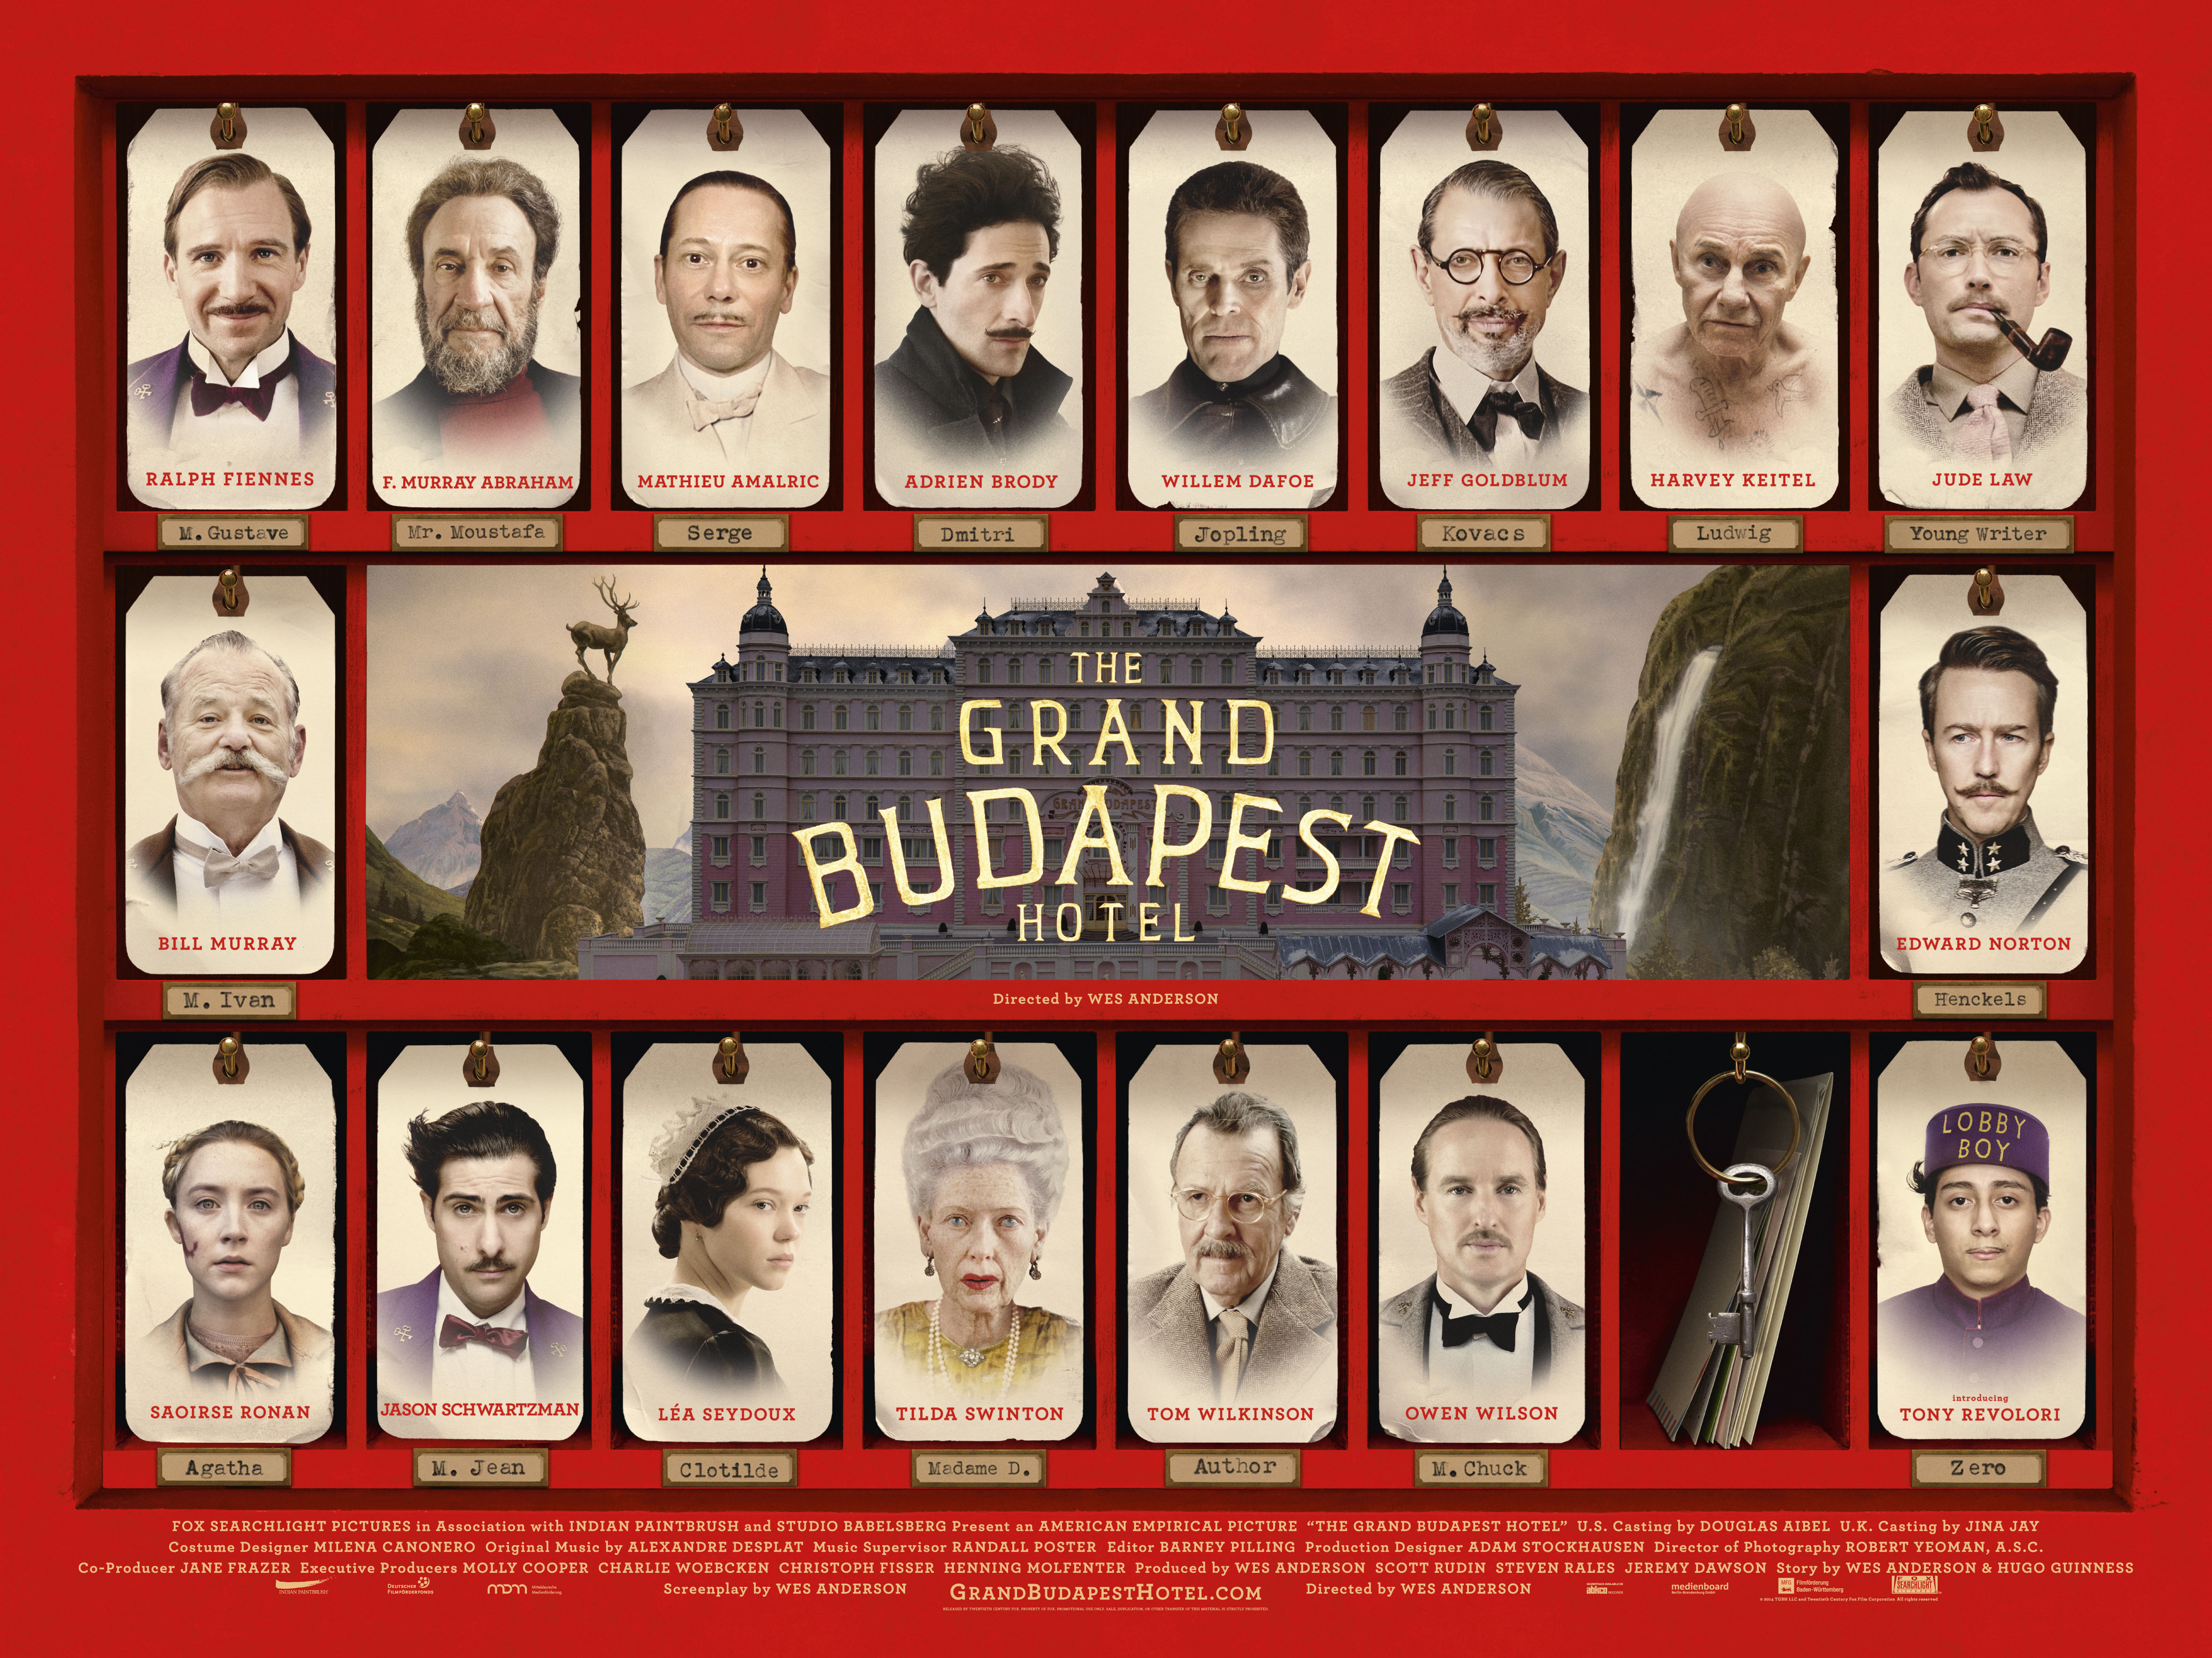

Slide 3
Story Summary
The story of The Grand Budapest Hotel is told through a series of flashbacks, moving back in time from the present day to 1985, then to 1968, and finally to 1932. The story takes place in the fictional mountain country of Zubrowka.
It begins with a young reader visiting the grave of a famous writer known as “the Author.” In his 1985 memoir, the Author recalls staying at the now rundown Grand Budapest Hotel, where he had dinner with the hotel’s mysterious owner, Zero Moustafa. During their meal, Zero shares the story of how he started as a lobby boy under the legendary concierge, Monsieur Gustave H., when the hotel was at its most glamorous between the world wars.

Slide 4
Story Summary
In 1932, young Zero arrives at the hotel as a refugee and quickly becomes Gustave’s devoted apprentice. One day, Gustave’s elderly lover, Madame D., dies, and her will shocks everyone, especially her angry son Dmitri, because it leaves a valuable painting called Boy with Apple to Gustave. Gustave takes the painting and flees, but Dmitri frames him for his mother’s murder. Gustave is arrested, but with Zero’s help, and some clever pastry smuggling from Zero’s fiancée Agatha, who works at a bakery, Gustave pulls off a daring escape from prison.

Slide 5
Story Summary
To prove Gustave’s innocence, the trio sets out to find Madame D.’s butler, Serge, who knows the truth. They get help from the secret “Society of the Crossed Keys,” a network of concierges from hotels all over Europe.
A series of chaotic events follow: Dmitri’s hired assassin kills witnesses, a chase on a ski slope ends with the assassin falling off a cliff, and the trio rushes back to the hotel, which has been taken over by soldiers.
In the scanner, you will view the movie segments where Gustave attempts to escape from jail with the help of Zero, and subsequently, Gustave and Zero seek assistance from the “Society of the Crossed Keys.”

Slide 6
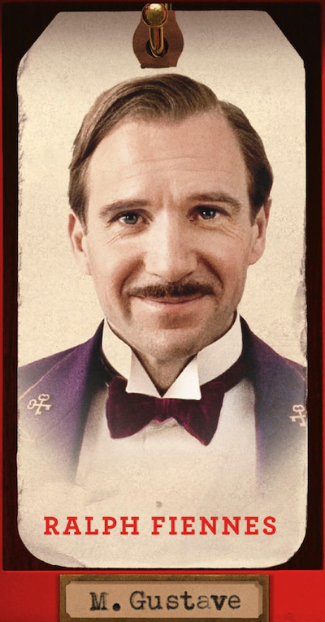
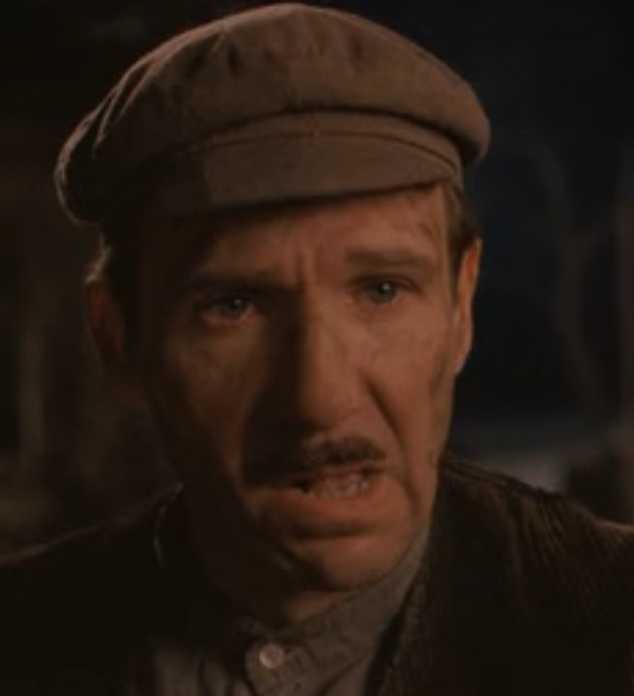
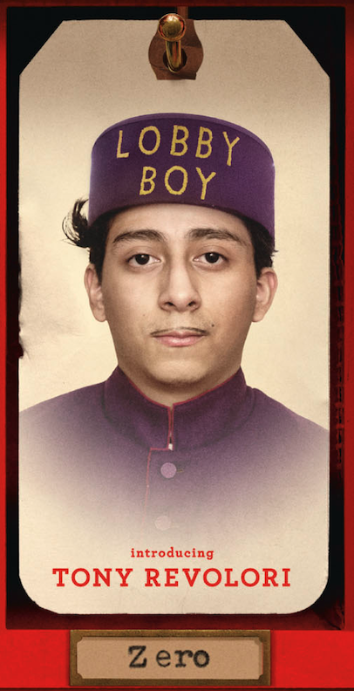
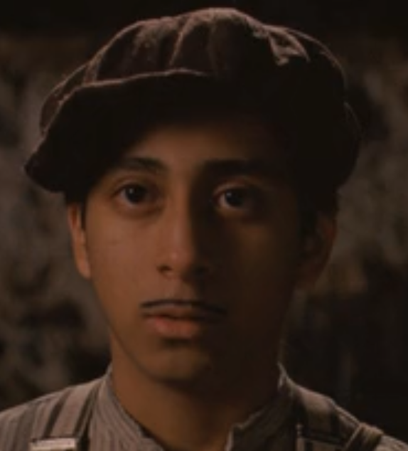
Major Characters

Slide 7
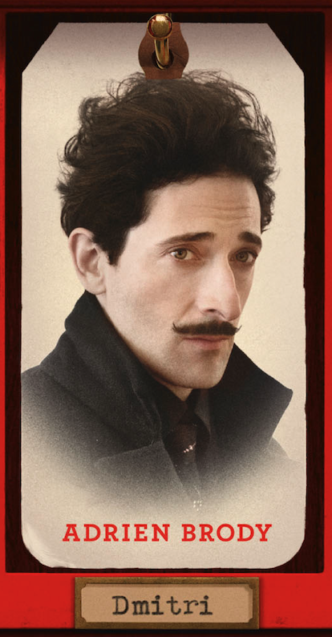
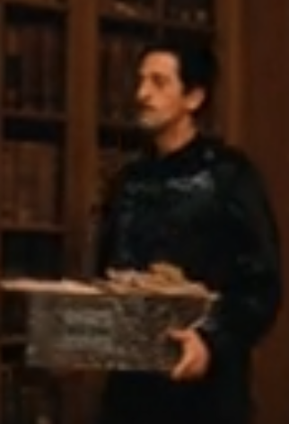
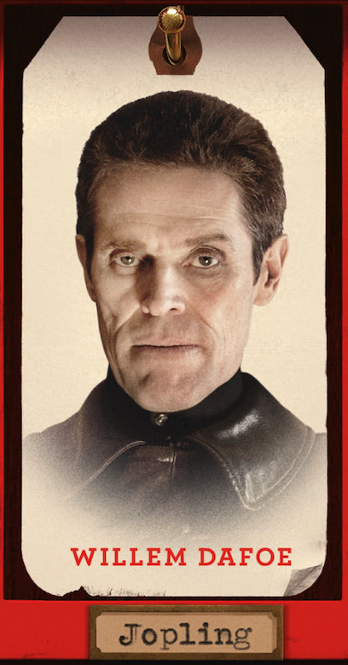
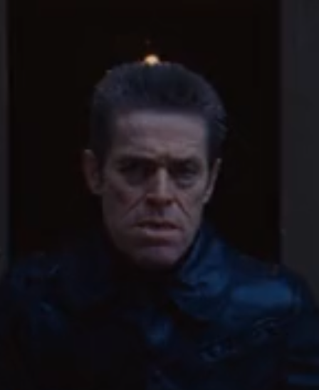
Major Characters
Madame D.’s angry son
The assassin hired by Dimitri

Slide 8
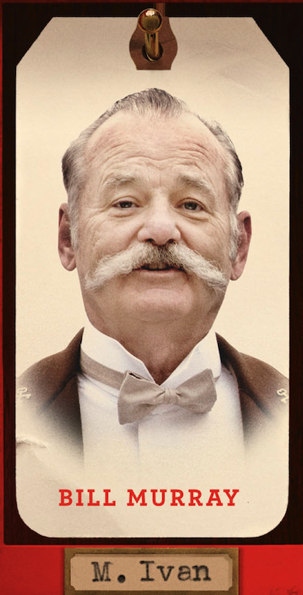
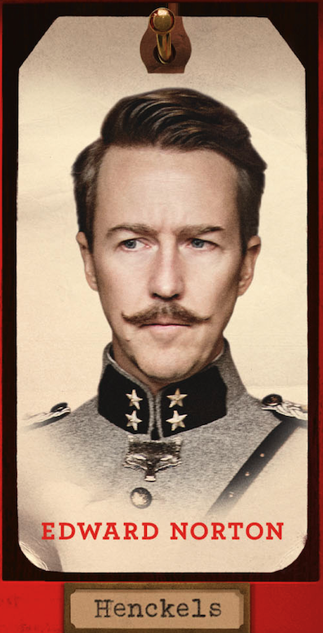
Other Characters You Might See
A senior member of the secretive “Society of the Crossed Keys”
Commander of Zubrowka’s gendarmerie

Slide 10
Story Summary -Ending
During a shootout in the lobby, Agatha finds the painting and discovers a hidden will on the back. This will declares Gustave the rightful heir to the hotel and Madame D.’s fortune. Dmitri runs away, and Gustave is cleared of all charges. The hotel briefly returns to its former glory.
Later, while traveling on a train, Gustave is killed by occupying soldiers after trying to protect Zero and Agatha. This marks the rise of authoritarian rule. In his will, Gustave leaves everything to Zero. Sadly, Zero later loses Agatha and their baby to an illness. By 1968, Zero still runs the now shabby hotel, keeping it alive only because it reminds him of the happier times and the old world of kindness and elegance that Gustave once represented.
Notes:
This slide can be presented to the participants after the scanning session is over.

